Slide 1

Olympic Analysis

Slide 2
INTRODUCTION
This analysis delves into the rich history of the Olympic Games, exploring diverse dimensions such as sports, events, participants, and medals. Through comprehensive data examination, it aims to uncover trends and insights vital for enhancing future Olympic organization and representation.

Slide 3

ER DIAGRAM

Slide 4
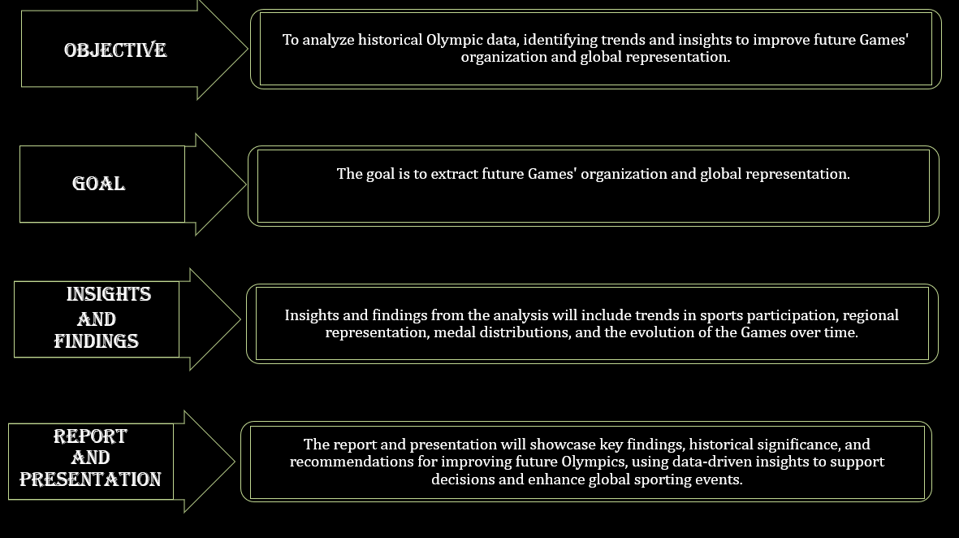

Slide 5
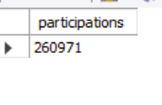
How many unique participations have occurred in the history of the Olympic Games?
OUTPUT
2,60,971
In the history of the Olympic Games, there have been a total of 260,971 unique participations.

Slide 6

How many unique sports are there in the dataset?
OUTPUT
66
In the history of the Olympic Games, there have been a total of 66 unique sports.

Slide 7
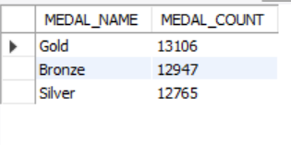
What is the distribution of medals (Gold, Silver, Bronze) across all Olympics?
OUTPUT
Across all Olympics, the distribution of medals is as follows:
Gold: 13,106 medals-34%
Silver: 12,765 medals-33%
Bronze: 12,947 medals-33%

Slide 8
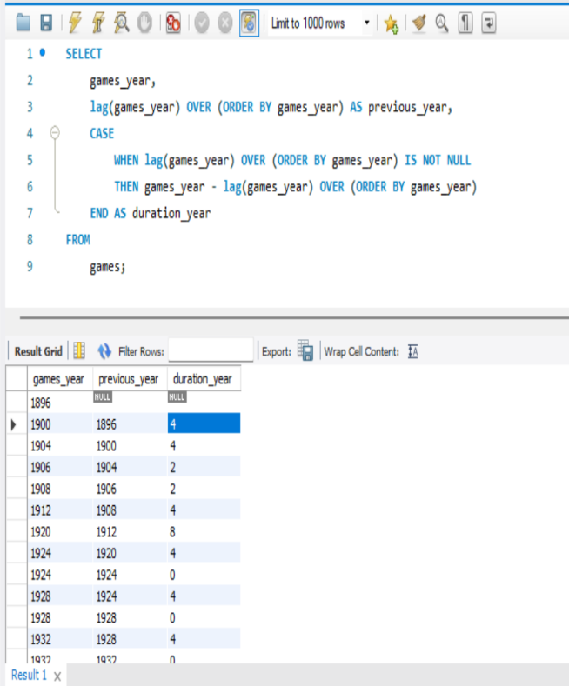
How has the duration of the Olympic Games changed over time?
OUTPUT
The dataset covering the Olympic Games from 1896 to 2016 indicates interruptions during 1916, 1940, and 1944, with variable durations between games ranging from 2 to 12 years. However, since 1960, the games have consistently occurred every four years

Slide 9
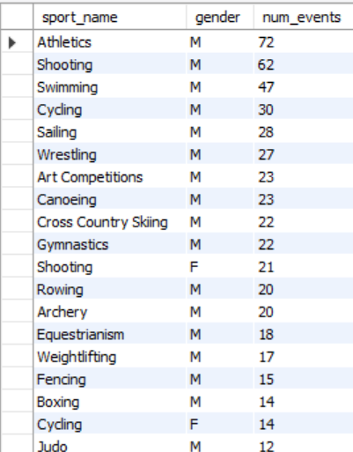
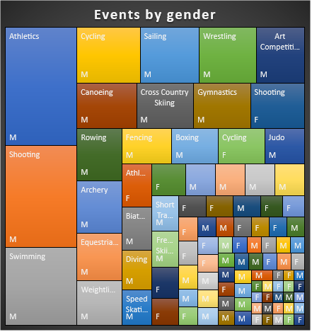
Are there any sports that have a higher number of events for one gender compared to others?
OUTPUT
The data highlights a clear difference in the number of events between genders across various sports. For instance, in Athletics, there are significantly more events available for men (72) compared to women (11). Similar gender imbalances are observed in many different sports as well.

Slide 10
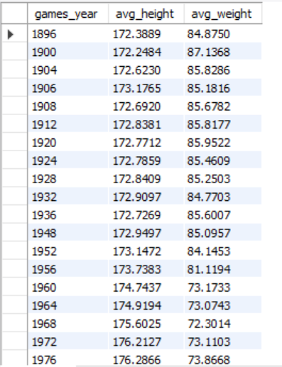
Are there any notable trends in the height and weight of participants over time?
OUTPUT
Height Trends: There's a notable increase from around 172.4 cm in 1896 to approximately 176.6 cm in 2016.
Weight Trends: There's a notable increase from around 66.5 kg in 1896, the average weight increases to about 71.8 kg by 2016.

Slide 11
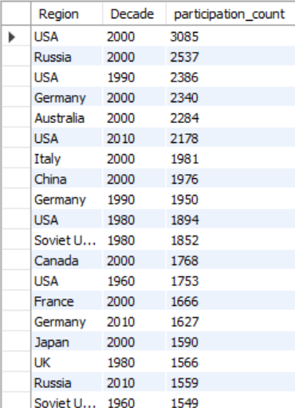
How does the number of participations vary by region across different decades of Olympic history?
OUTPUT
The United States has consistently recorded the highest number of participations in the Olympics across various decades, followed closely by Russia. Other regions have also demonstrated varying levels of participation over time.

Slide 12
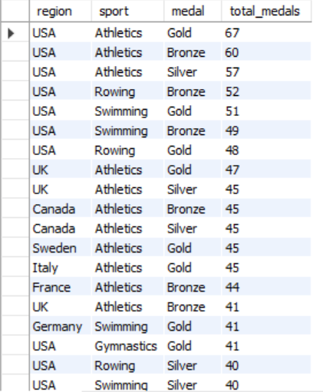
Are there any sports that have a higher number of medalists from a specific region?
OUTPUT
The United States (USA) has had a remarkable and notable impact on the overall medal tally, consistently emerging as one of the most successful nations in Olympic history. With its exceptional athletic prowess and extensive participation across various sports, the USA has secured the maximum number of medals compared to any other country.

Slide 13
Thank YOU

